Slide 1

Trauma
Overview
CHAPTER 25

Slide 2
National EMS Education Standard Competencies (1 of 3)
Trauma
Applies fundamental knowledge to provide basic emergency care and transportation based on assessment findings for an acutely injured patient.
Notes:
National EMS Education Standard Competencies
Trauma
Applies fundamental knowledge to provide basic emergency care and transportation based on assessment findings for an acutely injured patient.

Slide 3
National EMS Education Standard Competencies (2 of 3)
Trauma Overview
Pathophysiology, assessment, and management of the trauma patient
  Trauma scoring
  Rapid transport and destination issues
  Transport mode
Notes:
National EMS Education Standard Competencies
Trauma Overview
Pathophysiology, assessment, and management of the trauma patient
Trauma scoring
Rapid transport and destination issues
Transport mode

Slide 4
National EMS Education Standard Competencies (3 of 3)
Multisystem Trauma
Recognition and management of
  Multisystem trauma
Pathophysiology, assessment, and management of
  Multisystem trauma
  Blast injuries
Notes:
National EMS Education Standard Competencies
Multisystem Trauma
Recognition and management of
Multisystem trauma
Pathophysiology, assessment, and management of
Multisystem trauma
Blast injuries

Slide 5
Introduction (1 of 2)
For people younger than age 44, traumatic injuries are the leading cause of death in the United States.
  Traumatic emergencies occur as result of physical forces applied to the body.
  Medical emergencies occur from an illness or condition not caused by an outside force.
Notes:
Lecture Outline
I. Introduction
A. For people younger than age 44 years, traumatic injuries are the leading cause of death in the United States.
1. Trauma emergencies occur as a result of physical forces applied to the body.
2. Medical emergencies occur from an illness or condition not caused by an outside force.

Slide 6
Introduction (2 of 2)
Index of suspicion is your awareness and concern for potentially serious underlying and unseen injuries.
Notes:
Lecture Outline
3. Evaluation of the MOI for the trauma patient will provide you with an index of suspicion for different types of serious and/or life-threatening underlying injuries.
a. Index of suspicion is your awareness and concern for potentially serious underlying and unseen injuries.

Slide 7
Energy and Trauma (1 of 4)
Traumatic injury occurs when the body’s tissues are exposed to energy levels beyond their tolerance.
The mechanism of injury is the way traumatic injuries occur.
  Describes the forces acting on the body that cause injury
Notes:
Lecture Outline
II. Energy and Trauma
A. Traumatic injury occurs when the body’s tissues are exposed to energy levels beyond their tolerance.
1. Mechanism of injury describes the forces (or energy transmission) acting on the body that cause injury.

Slide 8
Energy and Trauma (2 of 4)
Three concepts of energy
  Potential energy
  Kinetic energy
  Energy of work
Energy can be neither created nor destroyed; it can only be converted or transformed.
Notes:
Lecture Outline
2. Three concepts of energy are typically associated with injury:
a. Potential energy
b. Kinetic energy
c. Energy of work
3. Energy can be neither created nor destroyed; it can only be converted or transformed.

Slide 9
Energy and Trauma (3 of 4)
Work is force acting over a distance.
Forces that bend, pull, or compress tissues beyond their inherent limits result in the work that causes injury.
Notes:
Lecture Outline
B. Work is defined as force acting over a distance.
1. Forces that bend, pull, or compress tissues beyond their inherent limits result in the work that causes injury.

Slide 10
Energy and Trauma (4 of 4)
Kinetic energy is the energy of a moving object.
  KE = ½ mass x velocity²
Potential energy is the product of mass, force of gravity, and height.
  Mostly associated with the energy of falling objects
Notes:
Lecture Outline
C. Kinetic energy is the energy of a moving object
1. Reflects the relationship between the mass (weight) of the object and the velocity (speech) at which it is traveling: KE = ½ mass x velocity²
D. Potential energy is the product of mass (weight), force of gravity, and height.
1. Mostly associated with the energy of falling objects

Slide 11
Mechanism of Injury Profiles (1 of 2)
Different MOIs produce many types of injuries.
Nonsignificant injuries
  Injury to an isolated body part
  Fall without the loss of consciousness
Notes:
Lecture Outline
III. Mechanism of Injury Profiles
A. Different types of MOIs will produce many types of injuries.
1. Nonsignificant MOIs
a. Injury to an isolated body part
b. A fall without the loss of consciousness

Slide 12
Mechanism of Injury Profiles (2 of 2)
Significant injuries:
  Injury to more than one body system (multisystem trauma)
  Falls from heights
  Motor vehicle and motorcycle crashes
  Car versus pedestrian (or bicycle)
  Gunshot wounds
  Stabbings
Notes:
Lecture Outline
2. Significant MOIs
a. Injury to more than one body system (multisystem trauma)
b. Falls from heights
c. Motor vehicle and motorcycle crashes
d. Car versus pedestrian (or bicycle or motorcycle)
e. Gunshot wounds
f. Stabbings

Slide 13
Blunt and Penetrating Trauma
Blunt trauma is the result of force to the body that causes injury without penetrating the soft tissues.
Penetrating trauma causes injury by objects that pierce and penetrate the surface of the body.
Either type may occur from a variety of MOIs.
Notes:
Lecture Outline
IV. Blunt and Penetrating Trauma
A. Traumatic injuries can be divided into two separate categories: blunt trauma and penetrating trauma.
1. Blunt trauma is the result of force to the body that causes injury without penetrating the soft tissues or internal organs and cavities.
2. Penetrating trauma causes injury by objects that primarily pierce and penetrate the surface of the body and cause damage to soft tissues, internal organs, and body cavities.
3. Either type may occur from a variety of MOIs.

Slide 14
Blunt Trauma
Results from an object making contact with the body
Motor vehicle crashes and falls are the most common MOIs.
Be alert to skin discoloration and pain.
Maintain a high index of suspicion for hidden injuries.
Notes:
Lecture Outline
V. Blunt Trauma
A. Blunt trauma results from an object making contact with the body.
1. Motor vehicle crashes and falls are the most common MOIs.
2. Be alert to skin discoloration and pain as they may be the only signs of blunt trauma.
3. Maintain a high index of suspicion for hidden injuries.

Slide 15
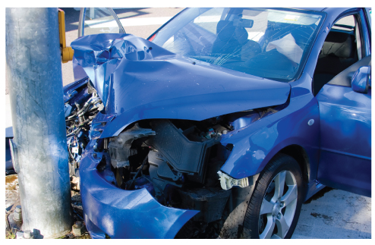
Vehicular Crashes (1 of 4)
A crash consists of three collisions.
Car against another car, tree, or object
  By assessing the vehicle, you can often determine the MOI.
FIGURE 25-3 The first collision in a typical impact is that of the vehicle against another object (in this case, a utility pole). The appearance of the vehicle can provide you with critical information about the severity of the crash. The greater the damage to the vehicle, the greater the energy that was involved.
© Rocketegg/iStock /Getty Images Plus/Getty Images.
Notes:
Lecture Outline
B. Vehicular crashes
1. A crash typically consists of three collisions.
a. Car against another car, tree, or object
i. By assessing the vehicle that has crashed, you can often determine the MOI.

Slide 16
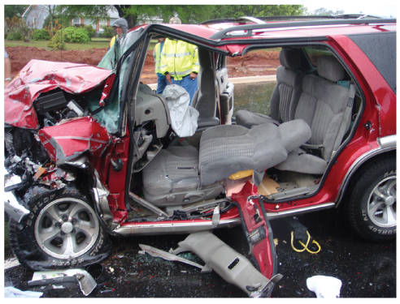
Vehicular Crashes (2 of 4)
Passenger against the interior of the car
  Common passenger injuries include lower extremity fractures, flail chest, and head trauma.
FIGURE 25-4 The second collision in a typical impact is that of the passenger against the interior of the car. The appearance of the interior of the car can provide you with information about the severity of the patient’s injuries
Courtesy of Rhonda Hunt.
Notes:
Lecture Outline
b. Passenger against the interior of the car
i. Kinetic energy produced by the passenger’s mass and velocity is converted into the work of stopping his or her body.
ii. Common passenger injuries include lower extremity fractures, rib fractures, and head trauma.

Slide 17
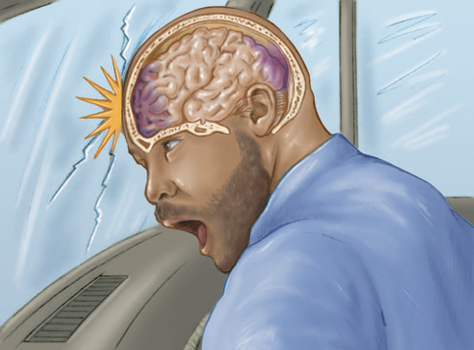
Vehicular Crashes (3 of 4)
Passenger’s internal organs against solid structures of the body
  Internal injuries may not be as obvious as external injuries but are often the most life threatening.
FIGURE 25-6 The third collision in a typical impact is that of the passenger’s internal organs against the solid structures of the body. A coup-contrecoup injury occurs when the brain continues its forward motion and strikes the inside of the skull (the coup), resulting in a compression injury to the anterior portion of the brain and a tension injury (stretching) of the posterior portion (the contrecoup).
© Jones & Bartlett Learning.
Notes:
Lecture Outline
c. Passenger’s internal organs against the solid structures of the body
i. Internal injuries may not be as obvious as external injuries, but they are often the most life threatening.

Slide 18
Vehicular Crashes (4 of 4)
Significant MOIs include the following findings:
  Death of an occupant in the vehicle
  Severe deformity of vehicle or intrusion into vehicle
  Severe damage from the rear
  Crashes in which rotation is involved
  Ejection from the vehicle
Notes:
Lecture Outline
d. Significant MOIs are suggested by:
a. Death of an occupant in the vehicle
b. Severe deformity of vehicle or intrusion into vehicle
c. Moderate intrusion from a lateral accident
d. Severe damage from the rear
e. Crashes in which rotation is involved
f. Ejection from the vehicle

Slide 19
Frontal Crashes (1 of 5)
Evaluate supplemental restraint system
  Determine whether the passenger was restrained and whether the airbags deployed.
  Seat belts and airbags are effective in preventing a second collision inside the motor vehicle.
  Airbags decrease the severity of deceleration injuries and decrease injury to the chest, face, and head.
Notes:
Lecture Outline
2. Frontal crashes
a. Evaluate the supplemental restraint system.
i. Determine whether the passenger was restrained by a full and properly applied three-point restraint.
ii. Determine whether the airbag was deployed.
b. Seat belts and airbags are effective in preventing a second collision inside the motor vehicle.
i. Seat belts may decrease the severity of the third collision.
ii. Airbags decrease the severity of deceleration injuries and decrease injury to the chest, face, and head.

Slide 20
Frontal Crashes (2 of 5)
Despite airbags, suspect injuries to:
  Extremities (resulting from the second collision)
  Internal organs (resulting from the third collision)
Notes:
Lecture Outline
c. Despite airbags, suspect injuries to:
i. Extremities (resulting from the second collision)
ii. Internal organs (resulting from the third collision)

Slide 21
Frontal Crashes (3 of 5)
Children shorter than 4’ 9" should ride in the rear seat.
Remember that if the airbag did not inflate during the accident, it may deploy during extrication.
Notes:
Lecture Outline
d. Children shorter than 4'-9″ should ride in the rear seat.
e. Remember that if the airbag did not inflate during the accident, it may deploy during extrication.

Slide 22
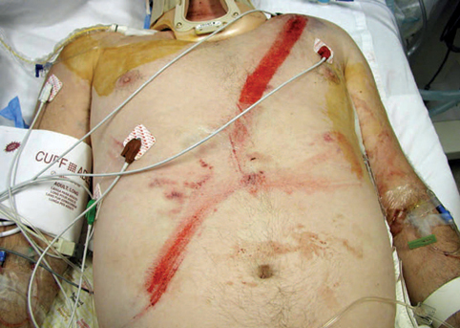
Frontal Crashes (4 of 5)
Remember that supplemental restraint systems can cause harm whether they are used properly or improperly.
FIGURE 25-7 Injuries can result if the seat belt is worn too high or too low across the waist. Although less common, injuries can also result from seat belts worn in the correct position across the torso.
Courtesy of ED, Royal North Shore Hospital/NSW Institute of Trauma & Injury.
Notes:
Lecture Outline
f. Remember that supplemental restraint systems can cause harm whether they are used properly or improperly.
i. Hip dislocations may result if seat belts are worn too low.
ii. Internal injuries can occur when the belt is worn too high.
iii. Lumbar spine fractures are also possible, particularly in children and older patients.

Slide 23
Frontal Crashes (5 of 5)
Look for contact points between the patient and the vehicle as you perform a simple, quick evaluation of the interior of the vehicle.
Notes:
Lecture Outline
h. Look for contact points between the patient and the vehicle as you perform a simple, quick evaluation of the interior of the vehicle.

Slide 24
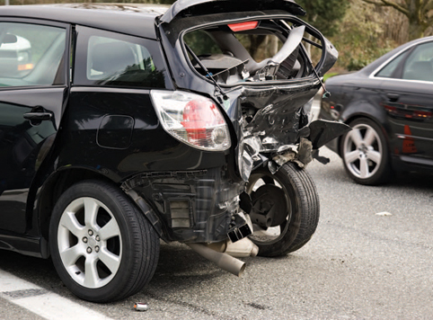
Rear-End Crashes (1 of 2)
Known to cause whiplash-type injuries
  Particularly in absence of a headrest
FIGURE 25-10 Rear-end impacts often cause whiplash
injuries, particularly when the head and/or neck is not
restrained by a headrest.
© Crystalcraig/Dreamstime.com.
Notes:
Lecture Outline
3. Rear-end crashes
a. Known to cause whiplash-type injuries, particularly in the absence of an appropriately placed headrest.

Slide 25
Rear-End Crashes (2 of 2)
As the body is propelled forward, the head and neck are left behind.
Acceleration-type injury to the brain is possible.
Notes:
Lecture Outline
b. As the body is propelled forward, the head and neck are left behind.
c. Acceleration-type injury to the brain is possible.
d. Passengers in the backseat wearing only a lap belt may have a higher incidence of injuries to the thoracic and lumbar spine.

Slide 26
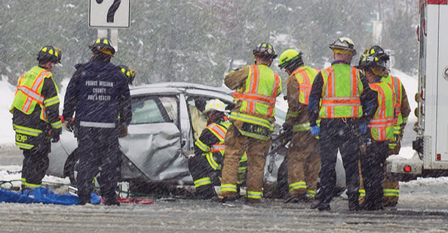
Lateral Crashes (1 of 3)
Side impacts
Very common cause of death associated with motor vehicle crashes
FIGURE 25-11 In a lateral crash, the car is typically struck
above its center of gravity and begins to rock away from
the side of impact. This causes a type of lateral whiplash
in which the passenger’s shoulders and head whip toward the intruding vehicle.
Notes:
Lecture Outline
4. Lateral crashes
a. A common cause of death associated with motor vehicle crashes.

Slide 27
Lateral Crashes (2 of 3)
A vehicle struck from the side is usually struck above its center of gravity.
  Begins to rock away from the side of impact
  Results in the passenger sustaining a lateral whiplash injury
Notes:
Lecture Outline
b. A vehicle struck from the side is usually struck above its center of gravity.
i. Begins to rock away from the side of impact
ii. This results in the passenger sustaining a lateral whiplash injury.

Slide 28
Lateral Crashes (3 of 3)
If substantial intrusion into the passenger compartment, suspect:
  Lateral chest and abdomen injuries on the side of the impact
  Possible fractures of the lower extremities, pelvis, and ribs
  Organ damage from the third collision
Notes:
Lecture Outline
c. If there is substantial intrusion into the passenger compartment, suspect:
i. Lateral chest and abdomen injuries on the side of the impact
ii. Possible fractures of the lower extremities, pelvis, and ribs
iii. Organ damage from the third collision

Slide 29
Rollover Crashes
Large trucks and sport utility vehicles are prone to rollovers.
Injuries depend on whether the passenger was restrained.
Most common life-threatening event is ejection or partial ejection of the passenger from the vehicle.
Notes:
Lecture Outline
5. Rollover crashes
a. Large trucks and sport utility vehicles are prone to rollovers because of their high center of gravity.
b. Injuries depend on whether the passenger was restrained.
c. The most common life-threatening event in a rollover is ejection or partial ejection of the passenger from the vehicle.
d. Even when restrained, passengers can sustain severe injuries.

Slide 30
Rotational Crashes
Spins are conceptually similar to rollovers.
Rotation of the vehicle provides opportunities for the vehicle to strike objects such as utility poles
Notes:
Lecture Outline
6. Rotational crashes
a. Rotational crashes (spins) are conceptually similar to rollovers.
b. The rotation of the vehicle as it spins provides opportunities for the vehicle to strike objects, such as utility poles.

Slide 31
Car Versus Pedestrian (1 of 2)
Injuries are often graphic and apparent.
Can also be serious unseen injuries
You should determine:
  Speed of the vehicle
  Whether the patient was thrown through the air
  Surface the patient landed on
  Whether the patient was struck and pulled under the vehicle
Notes:
Lecture Outline
C. Car versus pedestrian
1. Injuries are often graphic and apparent.
2. There can also be serious unseen injuries.
3. You should determine:
a. Speed of the vehicle
b. Whether the patient was thrown through the air and at what distance
c. Surface the patient landed on
d. Whether the patient was struck and pulled under the vehicle

Slide 32
Car Versus Pedestrian (2 of 2)
Evaluate the vehicle that struck the patient for structural damage.
ALS backup should be summoned for any patients who have sustained a significant MOI.
Notes:
Lecture Outline
4. Evaluate the vehicle that struck the patient for structural damage.
5. ALS backup should be summoned for any patients who have or are thought to have sustained a significant MOI.

Slide 33

Car Versus Bicycle (1 of 2)
Evaluate like you would for a car-versus-pedestrian collision.
  Evaluate the damage to and position of the bicycle.
  If the patient was wearing a helmet, inspect it for damage.
FIGURE 25-13 If the patient’s bike helmet is damaged, suspect head and spine injuries
© Robert Byron/Dreamstime.com.
Notes:
Lecture Outline
D. Car versus bicycle
1. Evaluate the MOI in much the same manner as car-versus-pedestrian crashes.
a. Evaluate the damage to, and position of, the bicycle.
b. If the patient was wearing a helmet, inspect it for damage.

Slide 34
Car Versus Bicycle (2 of 2)
Presume that the patient has sustained an injury to the spinal column, or spinal cord, until proven otherwise at the hospital.
Spinal stabilization must be initiated and maintained during the encounter.
Notes:
Lecture Outline
2. Presume that the patient has sustained an injury to the spinal column, or spinal cord, until proven otherwise at the hospital.
3. Spinal stabilization must be initiated and maintained during the encounter.

Slide 35
Car Versus Motorcycle (1 of 4)
Protection is from:
  Helmet
  Leather or abrasion-resistant clothing
  Boots
Notes:
Lecture Outline
E. Car versus motorcycle
1. Protection is from:
a. Helmet
i. Does not protect against severe cervical injury
b. Leather or abrasion-resistant clothing
i. Will protect against road abrasion but not against blunt trauma from secondary impacts
c. Boots

Slide 36
Car Versus Motorcycle (2 of 4)
When assessing the scene, look for:
  Deformity of the motorcycle
  Side of most damage
  Distance of skid in the road
  Deformity of stationary objects or other vehicles
  Extent and location of deformity in the helmet
Notes:
Lecture Outline
2. When assessing the scene of a motorcycle crash, look for:
a. Deformity of the motorcycle
b. Side of most damage
c. Distance of skid in the road
d. Deformity of stationary objects or other vehicles
e. Extent and location of deformity in the helmet

Slide 37
Car Versus Motorcycle (3 of 4)
Head-on crash
  Motorcycle strikes another object and stops its forward motion while the rider continues moving forward.
Angular crash
  Motorcycle strikes an object at an angle so that the rider sustains direct crushing injuries to the lower extremity.
Notes:
Lecture Outline
3. There are four types of motorcycle impacts.
a. Head-on crash
i. The motorcycle strikes another object and stops its forward motion while the rider continues his or her forward motion until stopped by an outside force.
b. Angular crash
i. The motorcycle strikes an object or another vehicle at an angle so that the rider sustains direct crushing injuries to the lower extremity between the object and the motorcycle.

Slide 38
Car Versus Motorcycle (4 of 4)
Ejection
  Rider will travel at high speed until stopped by a stationary object, another vehicle, or road drag.
Controlled crash
  Technique used to separate the rider from the body of the motorcycle
Notes:
Lecture Outline
c. Ejection
i. The rider will travel at high speed until stopped by a stationary object, another vehicle, or road drag.
d. Controlled crash
i. A technique used to separate the rider from the body of the motorcycle and the object to be hit is referred to as laying the bike down.

Slide 39
Falls (1 of 3)
Injury potential depends on the height from which the patient fell.
  More than 20 ft (6 m) is considered significant.
Internal injuries pose the greatest threat to life.
Notes:
Lecture Outline
F. Falls
1. The injury potential of a fall is related to the height from which the patient fell.
a. The greater the height of the fall, the greater the potential for injury.
b. A fall from more than 20 ft (6m) is considered significant.
2. Internal injuries pose the greatest threat to life.

Slide 40
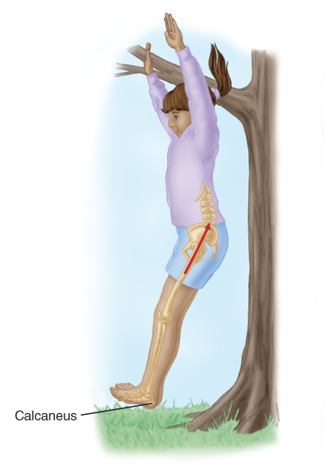
Falls (2 of 3)
Patients who fall and land on their feet may have less-severe internal injuries.
  Their legs may have absorbed much of the energy of the fall.
FIGURE 25-14 When a patient falls and lands on his or
her feet, the energy is transmitted to the spine, sometimes producing a spinal injury in addition to injuries to the legs and pelvis.
© Jones & Bartlett Learning.
Notes:
Lecture Outline
3. Patients who fall and land on their feet may have less severe internal injuries because their legs may have absorbed much of the energy of the fall.
a. However, they may have very serious injuries to the lower extremities and pelvic and spinal injuries.

Slide 41
Falls (3 of 3)
Take the following factors into account:
  The height of the fall
  The type of surface struck
  The part of the body that hit first, followed by the path of energy displacement
Notes:
Lecture Outline
4. Take into account:
a. The height of the fall
b. The type of surface struck
c. The part of the body that hit first, followed by the path of energy displacement

Slide 42
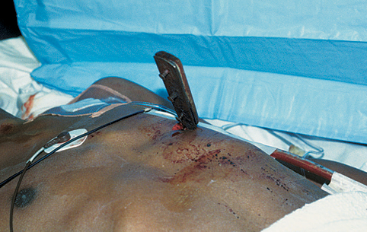
Penetrating Trauma (1 of 6)
Second-leading cause of trauma death after blunt trauma
  Accidentally by impalement
  Intentionally by a knife, ice pick, or other weapon
FIGURE 25-15 Injuries from low-energy penetrations,
such as a stab wound, are caused by the sharp edges of
the object moving through the body.
© Andrew Pollak, MD. Used with permission.
Notes:
Lecture Outline
VI. Penetrating Trauma
A. Penetrating trauma is the second leading cause of trauma death in the United States after blunt trauma.
1. Low-energy penetrating trauma may be caused:
a. Accidentally by impalement
b. Intentionally by a knife, ice pick, or other weapon

Slide 43
Penetrating Trauma (2 of 6)
With low-energy penetrations, injuries are caused by the sharp edges of the object moving through the body.
Knives may have been deliberately moved around internally, causing more damage than the external wounds suggest.
Notes:
Lecture Outline
2. With low-energy penetrations, injuries are caused by the sharp edges of the object moving through the body and are, therefore, close to the object’s path.
3. Knives may have been deliberately moved around internally, causing more damage than the external wound suggests.

Slide 44
Penetrating Trauma (3 of 6)
Path of the projectile may not be easy to predict.
  Bullet may ricochet within the body before exiting.
  Path the projectile takes is its trajectory.
  Fragmentation will increase damage.
Notes:
Lecture Outline
B. In medium- and high-velocity (speed) penetrating trauma, the path of the projectile (usually a bullet) may not be easy to predict.
1. The bullet may flatten out, tumble, or even ricochet within the body before exiting.
2. The path the projectile takes is its trajectory.
3. Fragmentation will increase damage.

Slide 45
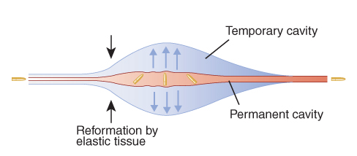
Penetrating Trauma (4 of 6)
Cavitation results from rapid changes in tissue and fluid pressure that occur with the passage of the projectile.
Can result in serious injury to internal organs
FIGURE 25-16 Two types of injury are caused by cavitation—temporary and permanent.
© Jones & Bartlett Learning.
Notes:
Lecture Outline
4. Cavitation results from rapid changes in tissue and fluid pressure that occur with the passage of the projectile.
a. Temporary cavitation injury results from a stretching of the tissues that occurs with pressure changes.
b. Permanent cavitation injury results closer to the bullet path and remains after the projectile has passed through the tissue.

Slide 46
Penetrating Trauma (5 of 6)
Relationship between distance and severity of injury varies depending on the type of weapon involved.
  Air resistance (drag) slows the projectile.
  Area damaged by projectiles is typically larger than the diameter of the projectile.
  Energy available for a bullet to cause damage is more a function of its speed than its mass.
Notes:
Lecture Outline
C. The relationship between distance and the severity of injury varies depending on the type of weapon involved.
1. Air resistance, often referred to as drag, slows the projectile, decreasing the depth of penetration and energy of the projectile, and thus reducing damage to the tissues.
2. The area that is damaged by medium- and high-velocity projectiles is typically many times larger than the diameter of the projectile itself.
a. This is one reason that exit wounds are often many times larger than entrance wounds.
3. The energy available for a bullet to cause damage is more a function of its speed than its mass.
4. An important factor for the seriousness of a gunshot wound is the type of tissue through which the projectile passes.

Slide 47
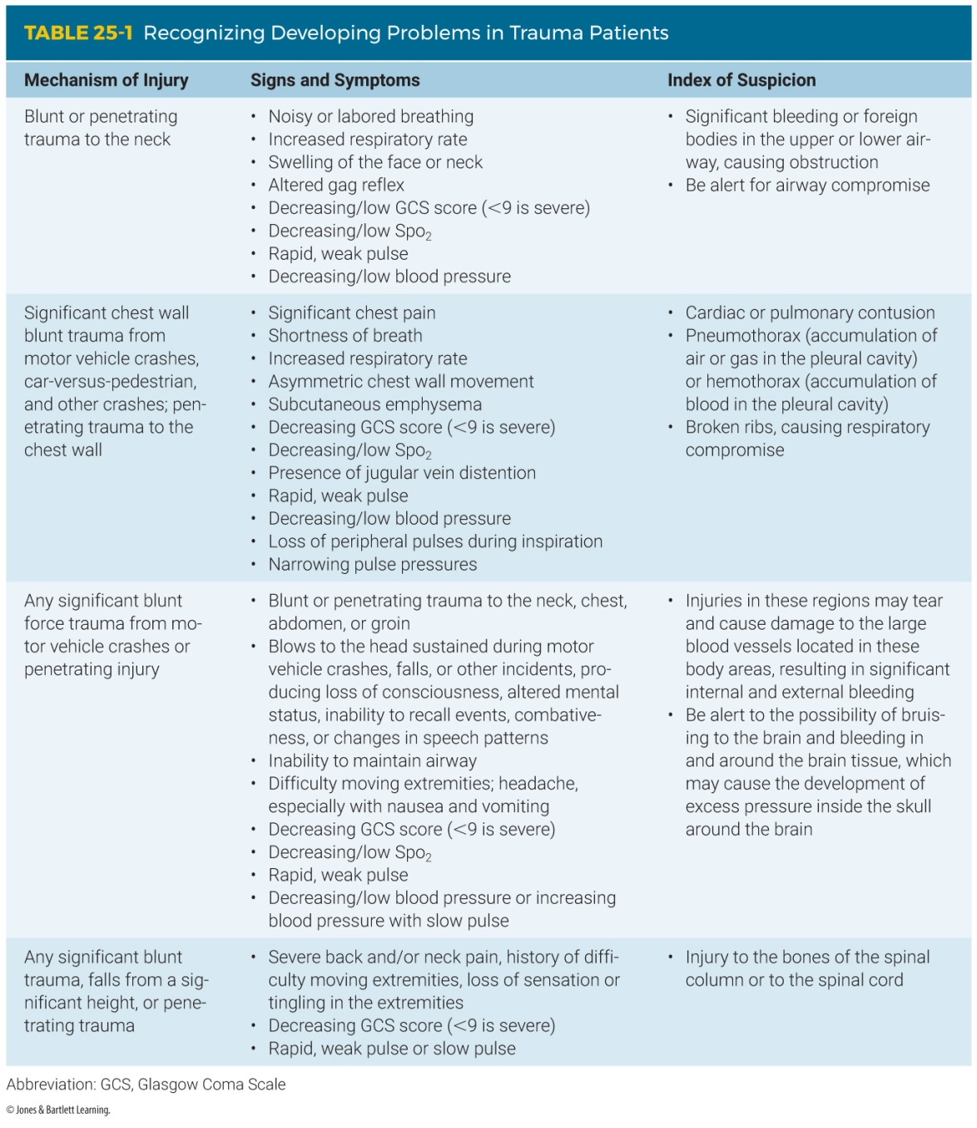
Penetrating Trauma (6 of 6)
Notes:
The table on this slide shows signs of developing problems in trauma patients.

Slide 48
Blast Injuries (1 of 7)
Most common in military conflict
Also seen in:
  Mines
  Shipyards
  Chemical plants
  Terrorist attacks
Notes:
Lecture Outline
VII. Blast Injuries
A. Although most commonly associated with military conflict, blast injuries are also seen in civilian practice in mines, shipyards, chemical plants, and in association with terrorist activities.

Slide 49
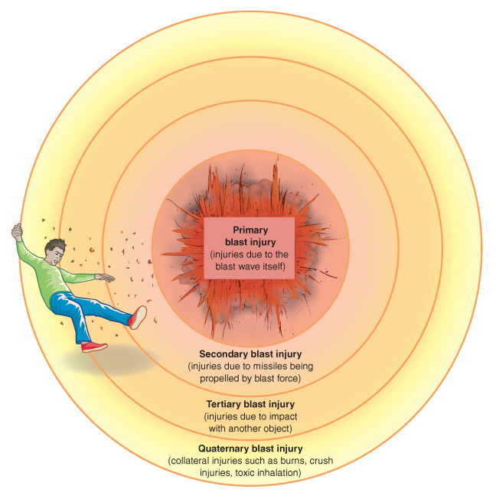
Blast Injuries (2 of 7)
FIGURE 25-18 Mechanisms of blast injuries.
© Jones & Bartlett Learning.
Notes:
The figure on this slide shows the four mechanisms of blast injuries.

Slide 50
Blast Injuries (3 of 7)
Primary blast injuries
  Due entirely to the blast itself
  Damage to the body by pressure wave
Secondary blast injuries
  Damage to the body results from being struck by flying debris.
Tertiary blast injuries
  Victim is hurled by the force of the explosion.
Notes:
Lecture Outline
1. People who are injured in explosions may be injured by four different mechanisms.
a. Primary blast injuries
i. These are due entirely to the blast itself.
ii. Damage to the body is caused by the pressure wave generated by the explosion.
b. Secondary blast injuries
i. Damage to the body results from being struck by flying debris.
c. Tertiary blast injuries
i. The victim is hurled by the force of the explosion against a stationary object.

Slide 51
Blast Injuries (4 of 7)
Quaternary (miscellaneous) blast injuries
  Burns from hot gases or fires started by the blast
  Respiratory injury from inhaling toxic gases
  Crush injury from the collapse of buildings
Most patients will have some combination of the four types of injury.
Notes:
Lecture Outline
d. Quaternary (miscellaneous) blast injuries
i. Burns from hot gases or fires started by the blast
ii. Respiratory injury from inhaling toxic gases
iii. Crush injury from the collapse of buildings
iv. Suffocation, poisoning, other medical emergencies
v. Contamination of wounds from environmental, chemical, or toxic substances
2. Most patients who survive an explosion will have some combination of the four types of injury mentioned.

Slide 52
Blast Injuries (5 of 7)
Organs that contain air are most susceptible to pressure changes.
  Middle ear
  Lung
  Gastrointestinal tract
The ear is most sensitive to blast injuries.
Notes:
Lecture Outline
B. Tissues at risk
1. Organs that contain air, such as the middle ear, lung, and gastrointestinal tract, are the most susceptible to pressure changes.
2. The ear is most sensitive to blast injuries.

Slide 53
Blast Injuries (6 of 7)
Pulmonary blast injuries result from short-range exposure to the detonation of explosives.
Arterial air embolisms can produce:
  Disturbances in vision
  Changes in behavior and state of consciousness
  Variety of other neurologic signs
Notes:
Lecture Outline
3. Pulmonary blast injuries are defined as pulmonary trauma that results from short-range exposure to the detonation of explosives.
4. Pneumothorax is a common injury and may require emergency decompression in the field.
5. One of the most concerning pulmonary blast injuries is arterial air embolism, which occurs on alveolar disruption with subsequent air embolization into the pulmonary vasculature.
a. Can produce:
i. Disturbances in vision
ii. Changes in behavior
iii. Changes in state of consciousness
iv. Variety of other neurologic signs

Slide 54
Blast Injuries (7 of 7)
Solid organs are relatively protected from shock wave injury.
Neurologic injuries and head trauma are the most common causes of death.
Traumatic amputations are common.
Notes:
Lecture Outline
6. Solid organs are relatively protected from shock wave injury but may be injured by secondary missiles or a hurled body.
7. Neurologic injuries and head trauma are the most common causes of death from blast injuries.
8. Extremity injures, including traumatic amputations, are common.

Slide 55
Multisystem Trauma
Involves more than one body system
  Head and spinal trauma
  Chest and abdominal trauma
  Chest and multiple extremity trauma
Alert medical control and transport rapidly.
Patients have a high level of morbidity and mortality.
Notes:
Lecture Outline
VIII. Multisystem Trauma
A. Multisystem trauma involves more than one body system.
1. Head and spinal trauma
2. Chest and abdominal trauma
3. Chest and multiple extremity trauma
4. You must alert medical control and transport rapidly.
5. Multisystem trauma patients have a high level of morbidity and mortality.

Slide 56
Golden Principles of Prehospital Trauma Care (1 of 3)
Your main priority is to ensure:
  Your safety
  Safety of your crew
  Safety of the patient
Determine the need for additional personnel or equipment.
Evaluate the MOI.
Notes:
Lecture Outline
B. Golden principles of prehospital trauma care
1. Your main priority is to ensure:
a. Your safety
b. Safety of your crew
c. Safety of the patient
2. Determine the need for additional personnel or equipment.
3. Evaluate the MOI.

Slide 57
Golden Principles of Prehospital Trauma Care (2 of 3)
Identify and manage life threats.
Then focus on patient care.
  Hemorrhage
  Airway and ventilatory support
  Shock
  Spinal immobilization
Transport immediately to the appropriate facility.
Notes:
Lecture Outline
4. Identify and manage life threats.
5. Then focus on patient care.
a. Hemorrhage control has the highest priority.
b. Assess and manage the airway including ventilatory support and high-flow oxygen while maintaining appropriate spinal restriction is the second priority.
c. Ensure that other shock therapy is completed.
d. Protect the spine and proceed with spinal immobilization if indicated
6. Transport the patient immediately to the appropriate facility.

Slide 58
Golden Principles of Prehospital Trauma Care (3 of 3)
Definitive care requires surgical intervention.
  On-scene time should be limited to 10 minutes or less.
Obtain a SAMPLE history and complete a secondary assessment.
Consider ALS intercept or air medical transportation.
Notes:
Lecture Outline
7. In most patients with multisystem trauma, definitive care requires surgical intervention.
a. On-scene time should be limited to 10 minutes or less.
8. During transport, obtain a SAMPLE history and complete a secondary assessment.
9. Consider ALS intercept and/or air medical transportation.

Slide 59
Patient Assessment
When a patient has experienced a significant MOI and is critical condition, rapidly perform a physical examination.
When a patient has experienced a nonsignificant MOI, focus on the chief complaint.
Notes:
Lecture Outline
IX. Patient Assessment
A. When you are caring for a patient who has experienced a significant MOI and the patient is considered to be in serious or critical condition, you should rapidly perform a physical examination.
1. With a patient who has experienced a nonsignificant MOI, focus on the chief complaint while assessing the patient as a whole.

Slide 60
Injuries to the Head
Disability and unseen injury to the brain may occur.
Bleeding or swelling inside the skull is often life threatening.
Include frequent neurologic examinations in your assessment.
Some patients will not have obvious signs or symptoms.
Notes:
Lecture Outline
B. Injuries to the head
1. Disability and unseen injury to the brain may occur.
2. Bleeding or swelling inside the skull is often life threatening.
3. Include frequent neurologic examinations in your assessment.
4. Some patients will not have obvious signs or symptoms until minutes or hours after the injury has occurred.

Slide 61
Injuries to the Neck and Throat (1 of 2)
Area of serious or deadly injuries
Airway problems may result.
Look for DCAP-BTLS in the neck region.
Swelling may prevent blood flow to the brain.
Notes:
Lecture Outline
C. Injuries to the neck and throat
1. Airway problems may result that could quickly become a serious life threat.
2. Your assessment must include frequent physical examinations looking for DCAP-BTLS in the neck region.
a. Also assess for jugular vein distention and tracheal deviation.
3. Swelling may prevent blood flow to the brain and cause injury to the central nervous system.

Slide 62
Injuries to the Neck and Throat (2 of 2)
Penetrating injury may result in air embolism.
Crushing injury may cause the cartilages of the upper airway and larynx to fracture.
Notes:
Lecture Outline
4. A penetrating injury may result in an air embolism.
5. A crushing injury to the upper part of the neck may cause the cartilages of the upper airway and larynx to fracture.

Slide 63
Injuries to the Chest (1 of 2)
Chest contains heart, lungs, and large blood vessels.
Many life-threatening injuries may occur.
  Broken ribs may hinder breathing.
  Heart may be bruised.
  Large vessels may be torn.
Notes:
Lecture Outline
E. Injuries to the chest
1. The chest contains the heart, lungs, and large blood vessels.
2. Many life-threatening injuries may occur.
a. Broken ribs may hinder breathing.
b. Bruising may occur to the heart and cause an irregular heartbeat.
c. Large vessels of the heart may be torn inside the chest, causing massive unseen bleeding.
d. Air may collect between the lung tissue and the chest wall, known as a pneumothorax.
e. The collection of blood in the chest is called a hemothorax.

Slide 64
Injuries to the Chest (2 of 2)
A penetration or perforation of the integrity of the chest is called an open chest wound.
  If untreated, shock and/or death will result.
  Assess the chest region every 5 minutes.
  Assessment should include DCAP-BTLS, lung sounds, and chest rise and fall.
Notes:
Lecture Outline
3. A penetration or perforation of the integrity of the chest is called an open chest wound.
a. If left untreated, shock and/or death will result.
b. It is imperative that you assess the chest region every 5 minutes.
c. Assessment should include DCAP-BTLS, lung sounds, and chest rise and fall.

Slide 65
Injuries to the Abdomen (1 of 2)
Abdomen contains vital organs that require a very high amount of blood flow.
Solid organs include the liver, spleen, pancreas, and kidneys.
Hollow organs include the stomach, large and small intestines, and urinary bladder.
Notes:
Lecture Outline
F. Injuries to the abdomen
1. The abdomen contains vital organs that require a very high amount of blood flow to perform the functions necessary for life.

Slide 66
Injuries to the Abdomen (2 of 2)
Solid organs may tear, lacerate, or fracture.
Hollow organs may rupture and leak toxic digestive chemicals.
The rupture of large blood vessels can cause serious unseen bleeding.
Notes:
Lecture Outline
2. Solid organs may tear, lacerate, or fracture, which can cause serious bleeding into the abdomen.
a. Solid organs include the liver, spleen, pancreas, and kidneys.
3. Hollow organs may rupture and leak toxic digestive chemicals causing the possibility of a life-threatening infection.
a. Hollow organs include the stomach, large and small intestines, and urinary bladder.
4. The rupture of large blood vessels can cause serious unseen bleeding.

Slide 67
Management: Transport and Destination (1 of 8)
Scene time
  Survival of critically injured trauma patients is time dependent.
  Limit on-scene time to less than 10 minutes.
  Critically injured patient:
    Dangerous MOI
    Decreased level of consciousness
    Threats to airway, breathing, or circulation
Notes:
Lecture Outline
X. Management: Transport and Destination
A. Scene time
1. Survival of critically injured trauma patients is time dependent.
2. On-scene time for critically injured patients should be less than 10 minutes.
3. The following criteria will help you identify a critically injured patient:
a. Dangerous MOI
b. Decreased level of consciousness
c. Any threats to airway, breathing, or circulation
4. Patients who are very young or old or have chronic illnesses should also be considered to high risk.

Slide 68
Management: Transport and Destination (2 of 8)
Destination selection
  Level I facility
    Serves large cities or heavily populated areas
    Provides every aspect of trauma care
    Usually university-based hospitals
  Level II facility
    Located in less population-dense areas
    Provides initial definitive care
Notes:
Lecture Outline
B. Destination selection
1. Trauma centers are classified into Levels I through IV, with Level I having the most resources.
a. Level I facility provides every aspect of trauma care
b. Level II facility provides initial definitive care

Slide 69
Management: Transport and Destination (3 of 8)
Destination selection (cont’d)
  Level III facility
    Provides assessment, resuscitation, emergency care, and stabilization
    Transfers patients to Level I or Level II facility when necessary
  Level IV facility
    Found in remote outlying areas
    Provides advanced trauma life support
Notes:
Lecture Outline
c. Level III facility
i. Provides assessment, resuscitation, emergency care, and stabilization
d. Level IV facility
i. Provides advanced trauma life support

Slide 70
Management: Transport and Destination (4 of 8)
AAMS and MedEvac Foundation International identify criteria for emergency air medical services for trauma patients.
  Extended period required to access or extricate a remote or trapped patient
  Patient needs ALS care and no ALS-level ground ambulance service is available
  Multiple trauma patients
  Mass-casualty incident
Notes:
Lecture Outline
2. The Association of Air Medical Services (AAMS) and MedEvac Foundation International identify the following criteria for appropriate use of emergency air medical services for trauma patients:
a. There is an extended period required to access or extricate a remote or trapped patient.
b. The distance to the trauma center is more than 20 to 25 miles.
c. The patient needs ALS care and there is no ALS-level ground ambulance service available within a reasonable time frame.
d. Traffic conditions or hospital availability make it unlikely that the patient will get to a trauma center via ground ambulance within the ideal time frame.
e. There are multiple trauma patients who will overwhelm resources at the nearby trauma center(s).
f. EMS systems require bringing a patient to the nearest hospital, rather than bypassing facilities to go directly to a trauma center. This may add delay to receiving definitive surgical care.
g. There is a mass-casualty incident.

Slide 71
Management: Transport and Destination (5 of 8)
Trauma centers are categorized as either adult trauma centers or pediatric trauma centers.
Do not transport a pediatric patient to an adult trauma center when a pediatric trauma center is available.
Notes:
Lecture Outline
3. Trauma centers are categorized as either adult trauma centers or pediatric trauma centers, but not necessarily both.

Slide 72
Management: Transport and Destination (6 of 8)
Type of transport
  Ground EMS units are staffed by EMTs and paramedics.
  Air EMS units or critical care transport units are staffed by critical care nurses and paramedics.
Notes:
Lecture Outline
C. Type of transport
1. Modes of transport ultimately come in one of two categories: ground or air.
a. Ground EMS units are staffed by EMTs and paramedics.
b. Air EMS units or critical care transport units are staffed by critical care nurses and paramedics.

Slide 73
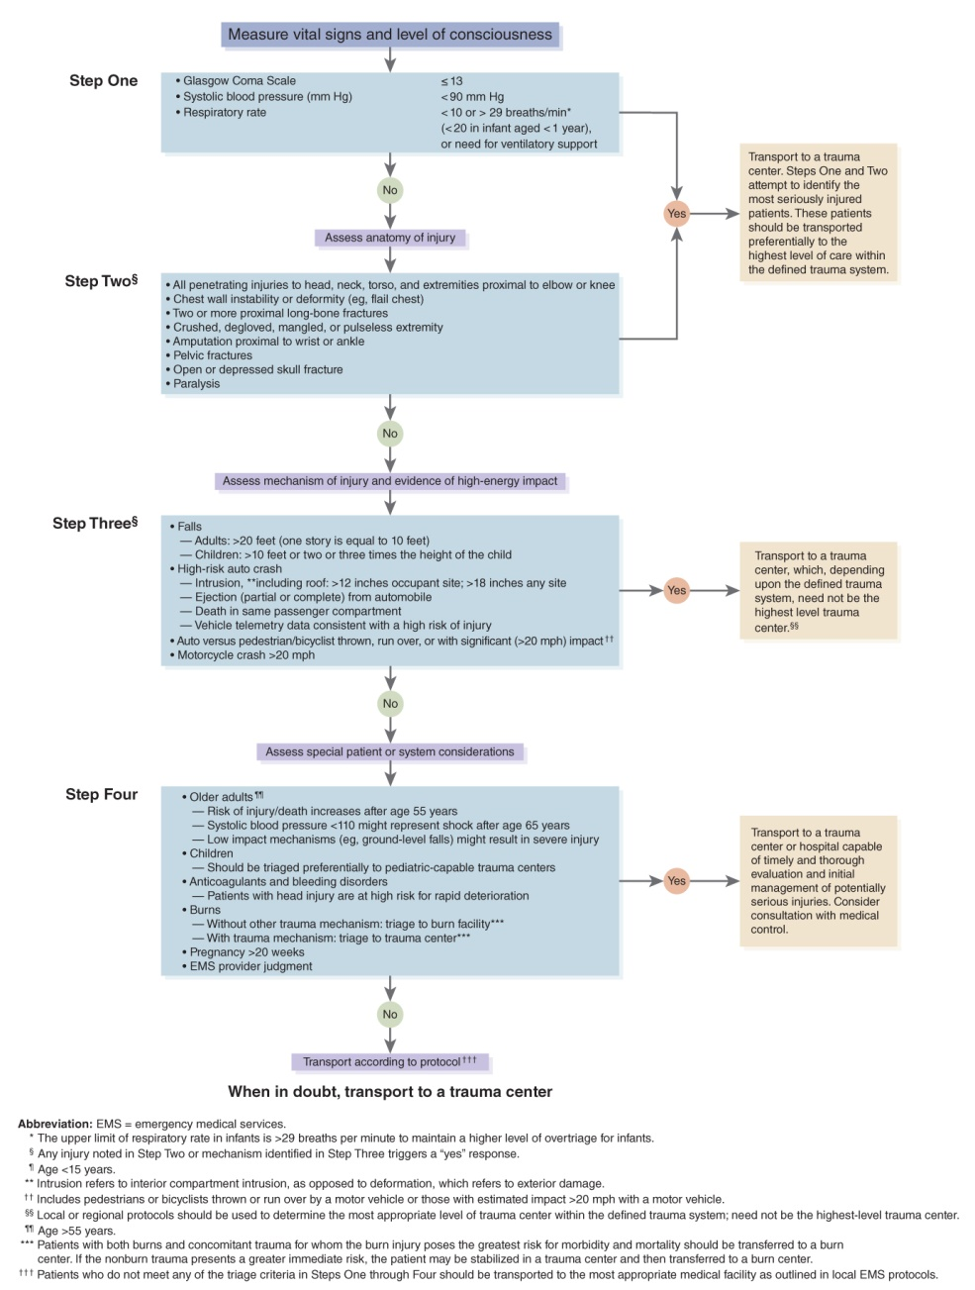
Management: Transport and Destination (7 of 8)
FIGURE 25-19 2011 decision scheme for field triage of injured patients.
Adapted from Centers for Disease Control and Prevention, Morbidity and Mortality Weekly Report, January 13, 2012.
Notes:
Lecture Outline

Slide 74
Management: Transport and Destination (8 of 8)
Special considerations
  Remain calm.
  Complete an organized assessment.
  Correct life-threatening injuries.
  Do no harm.
  Never hesitate to contact ALS backup or medical control for guidance.
Notes:
Lecture Outline
D. Special considerations
1. Remain calm.
2. Complete an organized assessment.
3. Correct life-threatening injuries.
4. Do no harm.
5. Never hesitate to contact ALS backup or medical control for guidance.

Slide 75
Review
Kinetic energy is a calculation of:
  weight and size.
  weight and speed.
  mass and weight.
  speed and force.

Slide 76
Review
Answer: B
Rationale: Kinetic energy is a calculation of mass (weight) and velocity (speed). Energy cannot be destroyed, only converted.

Slide 77
Review
Kinetic energy is a calculation of:
  weight and size.
  Rationale: Weight is part of the formula, but size would also mean weight.
  weight and speed.
  Rationale: Correct answer
  C. mass and weight.
  Rationale: Mass and weight are the same.
  D. speed and force.
  Rationale: Force is the product of mass times acceleration, all part of Newton’s second law.

Slide 78
Review
A 20-year-old man has major open facial injuries after his vehicle struck a tree head-on. Which of the following findings within the car would MOST likely explain his injury pattern?
  Deployed airbag
  Bent steering wheel
  Nonintact windshield
  Crushed instrument panel

Slide 79
Review
Answer: C
Rationale: The mechanism of injury and condition of the vehicle’s interior suggest likely areas of injury. Head and neck injuries are likely to result when the head and face impact the windshield.

Slide 80
Review
A 20-year-old man has major open facial injuries after his vehicle struck a tree head-on. Which of the following findings within the car would MOST likely explain his injury pattern?
  Deployed airbag
  Rationale: This typically results in abrasions of the face, head, and arms.
  Bent steering wheel
  Rationale: This typically indicates the presence of chest injuries.
  Nonintact windshield
  Rationale: Correct answer
  Crushed instrument panel
  Rationale: This typically indicates the presence of leg and hip injuries.

Slide 81
Review
Which of the following would MOST likely result from the third collision in the “three-collision” effect that occurs during a high-speed, frontal impact motor vehicle crash?
  Extensive damage to the automobile
  Flail chest and lower extremity fractures
  Massive external trauma with severe bleeding
  Aortic rupture or compression injury to the brain

Slide 82
Review
Answer: D
Rationale: During the third collision, the body's internal organs collide with the inside of the body. These injuries are usually not as obvious, but are often the most life-threatening. Injuries that may result from this include internal injuries of the brain (compression injuries) and aortic tears, resulting in massive internal bleeding.

Slide 83
Review
Which of the following would MOST likely result from the third collision in the “three-collision” effect that occurs during a high-speed, frontal impact motor vehicle crash?
  Extensive damage to the automobile
  Rationale: This would occur in the first collision.
  Flail chest and lower extremity fractures
  Rationale: This would occur in the second collision.
  Massive external trauma with severe bleeding
  Rationale: This would occur in the second collision.
  Aortic rupture or compression injury to the brain
  Rationale: Correct answer

Slide 84
Review
A young male experienced severe blunt chest trauma when his passenger car struck another vehicle head-on. During your inspection of the interior of his vehicle, you would MOST likely find:
  deployed airbags.
  steering wheel deformity.
  starring of the windshield.
  a crushed instrument panel.

Slide 85
Review
Answer: B
Rationale: Blunt chest injuries during a motor vehicle crash typically occur when the chest impacts the steering wheel. Therefore, your inspection of the vehicle’s interior will most likely reveal a deformed steering wheel.

Slide 86
Review
A young male experienced severe blunt chest trauma when his passenger car struck another vehicle head-on. During your inspection of the interior of his vehicle, you would MOST likely find:
  deployed airbags.
  Rationale: Typically, this will cause abrasions to the face, head, and arms.
  steering wheel deformity.
  Rationale: Correct answer
  starring of the windshield.
  Rationale: Typically, this indicates the presence of head, face, and neck injuries.
  a crushed instrument panel.
  Rationale: Typically, this indicates the presence of leg and hip injuries.

Slide 87
Review
An unrestrained driver collided with a bridge pillar. Upon inspection of the interior of his vehicle, you note that the lower dashboard is crushed. During your assessment of the patient, you will MOST likely encounter:
  trauma to the pelvis.
  blunt abdominal trauma.
  a severe closed head injury.
  penetrating thoracic trauma.

Slide 88
Review
Answer: A
Rationale: Impact points are often obvious from a quick inspection of the vehicle’s interior. During a frontal collision, the unrestrained occupant’s knees often impact the lower dashboard. With this type of impact, energy is transferred from the knees to the femurs, and then to the pelvis or hip.

Slide 89
Review
An unrestrained driver collided with a bridge pillar. Upon inspection of the interior of his vehicle, you note that the lower dashboard is crushed. During your assessment of the patient, you will MOST likely encounter:
  trauma to the pelvis.
  Rationale: Correct answer
  blunt abdominal trauma.
  Rationale: This is usually a result of striking the steering wheel.
  a severe closed head injury.
  Rationale: This is usually the result of striking the windshield.
  penetrating thoracic trauma.
  Rationale: This is usually caused by flying debris, collision with parts of the vehicle, or other movable objects.

Slide 90
Review
Whiplash injuries are MOST common following _________ impacts.
  rear-end
  rollover
  frontal
  lateral

Slide 91
Review
Answer: A
Rationale: Whiplash injuries of the neck are a common occurrence following rear-end collisions. As the vehicle is suddenly thrust forward, the occupant’s head is thrust backward. Properly positioned headrests can minimize the severity of whiplash injuries.

Slide 92
Review
Whiplash injuries are MOST common following _________ impacts.
  rear-end
  Rationale: Correct answer
  rollover
  Rationale: This typically causes life-threatening injuries.
  frontal
  Rationale: This typically causes chest, head, abdominal, and extremity injuries.
  lateral
  Rationale: You should suspect lateral chest and abdominal injuries on the side of impact, as well as pelvic injuries.

Slide 93
Review
Death from a rollover motor vehicle crash is MOST often secondary to:
  crushing injuries.
  airbag-related trauma.
  multiple collisions to the interior of the car.
  ejection of the patient from the motor vehicle.

Slide 94
Review
Answer: D
Rationale: Rollover crashes are the most unpredictable with regard to injuries sustained by the patient. An unrestrained passenger may have struck multiple points within the vehicle. However, the most life-threatening event in a rollover is ejection or partial ejection of the patient from the vehicle.

Slide 95
Review
Death from a rollover motor vehicle crash is MOST often secondary to:
  crushing injuries.
  Rationale: These injuries occur during ejection or partial ejection.
  airbag-related trauma.
  Rationale: Airbags significantly reduce the risk of death in motor vehicle crashes.
  multiple collisions to the interior of the car.
  Rationale: This makes the prediction of injury patterns difficult, but is not the most common life-threatening event in a rollover.
  ejection of the patient from the motor vehicle.
  Rationale: Correct answer

Slide 96
Review
Severe abrasion injuries can occur when motorcycle riders are slowed after a collision by road drag. Road drag is most often associated with which type of motorcycle impact?
  Head-on collision
  Angular collision
  Ejection
  Controlled crash

Slide 97
Review
Answer: C
Rationale: During an ejection, the rider will travel at high speed until stopped by a stationary object, another vehicle, or road drag. Severe abrasion injuries (road rash) down to bone can occur with drag.

Slide 98
Review
Severe abrasion injuries can occur when motorcycle riders are slowed after a collision by road drag. Road drag is most often associated with which type of motorcycle impact?
  Head-on collision
  Rationale: Road drag can occur in a head-on collision, but is more often associated with an ejection.
  Angular collision
  Rationale: Road drag can occur in an angular collision, but is more often associated with an ejection.
  Ejection
  Rationale: Correct answer
  Controlled crash
  Rationale: Road drag can occur in a controlled crash, but is more often associated with an ejection.

Slide 99
Review
When assessing a stab wound, it is important for the EMT to remember that:
  stabbings to an extremity are rarely associated with an exit wound.
  the majority of the internal trauma will be near the path of the knife.
  most stabbings are unintentional and cause less severe internal injury.
  more internal damage may be present than the external wound suggests.

Slide 100
Review
Answer: D
Rationale: With low-velocity penetrations, injuries are caused by sharp edges of the object moving through the body and are therefore close to the object’s path. Weapons such as knives, however, may have been deliberately moved around internally, causing more internal damage than the external wound suggests.

Slide 101
Review
When assessing a stab wound, it is important for the EMT to remember that:
  stabbings to an extremity are rarely associated with an exit wound.
  Rationale: The question did not state that the wound was to an extremity.
  the majority of the internal trauma will be near the path of the knife.
  Rationale: This is true, but EMS providers must have a high index of suspicion for extended injuries due to movement.
  most stabbings are unintentional and cause less severe internal injury.
  Rationale: Any stabbing that penetrates an individual’s skin must be considered severe until ruled out by a hospital physician.
  more internal damage may be present than the external wound suggests.
  Rationale: Correct answer

Slide 102
Review
A 40-year-old man was standing near a building when it exploded. He has multiple injuries, including a depressed skull fracture, severe burns, and an impaled object in his abdomen. His head injury was MOST likely caused by ___________ blast injuries.
  primary
  secondary
  tertiary
  quaternary

Slide 103
Review
Answer: C
Rationale: Primary blast injuries are caused by the pressure wave and include ruptured eardrums and hollow organ rupture. Secondary blast injuries are caused by flying debris and include impaled objects and shrapnel injuries. Tertiary blast injuries occur when the victim is thrown into a solid object, resulting in blunt trauma to virtually any part of the body. Quaternary blast injuries include other miscellaneous injuries.

Slide 104
Review
A 40-year-old man was standing near a building when it exploded. He has multiple injuries, including a depressed skull fracture, severe burns, and an impaled object in his abdomen. His head injury was MOST likely caused by ___________ blast injuries.
  primary
  Rationale: These injuries include damage eardrums, lungs, and hollow organs.
  secondary
  Rationale: These injuries are caused by flying debris and usually involve impalement.
  tertiary
  Rationale: Correct answer
  quaternary
  Rationale: These injuries include burns, respiratory injuries, and crush injuries.

